Slide 1
NICHOLAS COUNTY US 68 SCRUB SEAL
FIRST PM TREATMENT OVER AN EXISTING PM SURFACE
EXISTING SURFACE – DOUBLE COURSE MICROSURFACE
COMPLETED SEPTEMBER 2010
STRAWSER CONSTRUCTION
TOTAL COST $388,600 ($4.32 / S.Y.) ($30,400 /LN-MI)
INITIAL RECOMMENDATION WAS TO CRACKSEAL ENTIRE SECTION
EVENTUAL DECISION TO APPLY SCRUB SEAL
SCRUB SEAL COST - $246,000 ($2.32 / S.Y.) ($18,440/ LN-MI)

Slide 2
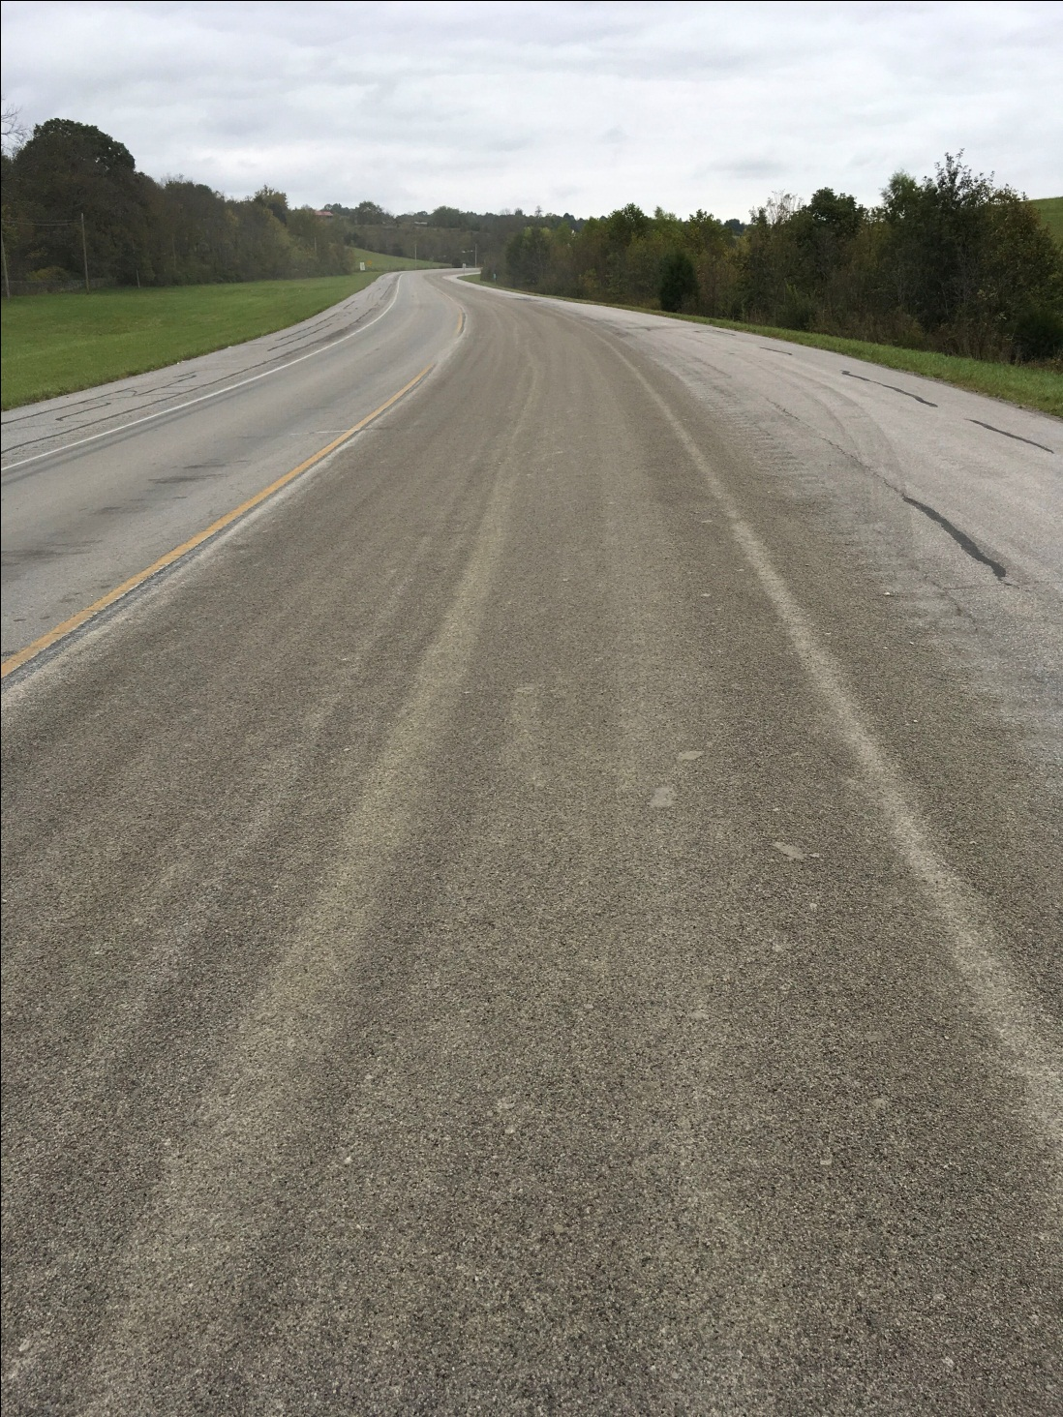
6.03 mi. with 0.7 mi truck lane
US 68
Nicholas
County
Carried 1’ onto shoulder
Wanted 500 ton patching
Used 225 ton
No crack seal used
Emulsion = .317 (.22 - .35)
Aggregate = 17.9 (16 – 22)
Fog Seal = 0.07 (0.1 – 0.15)

Slide 3
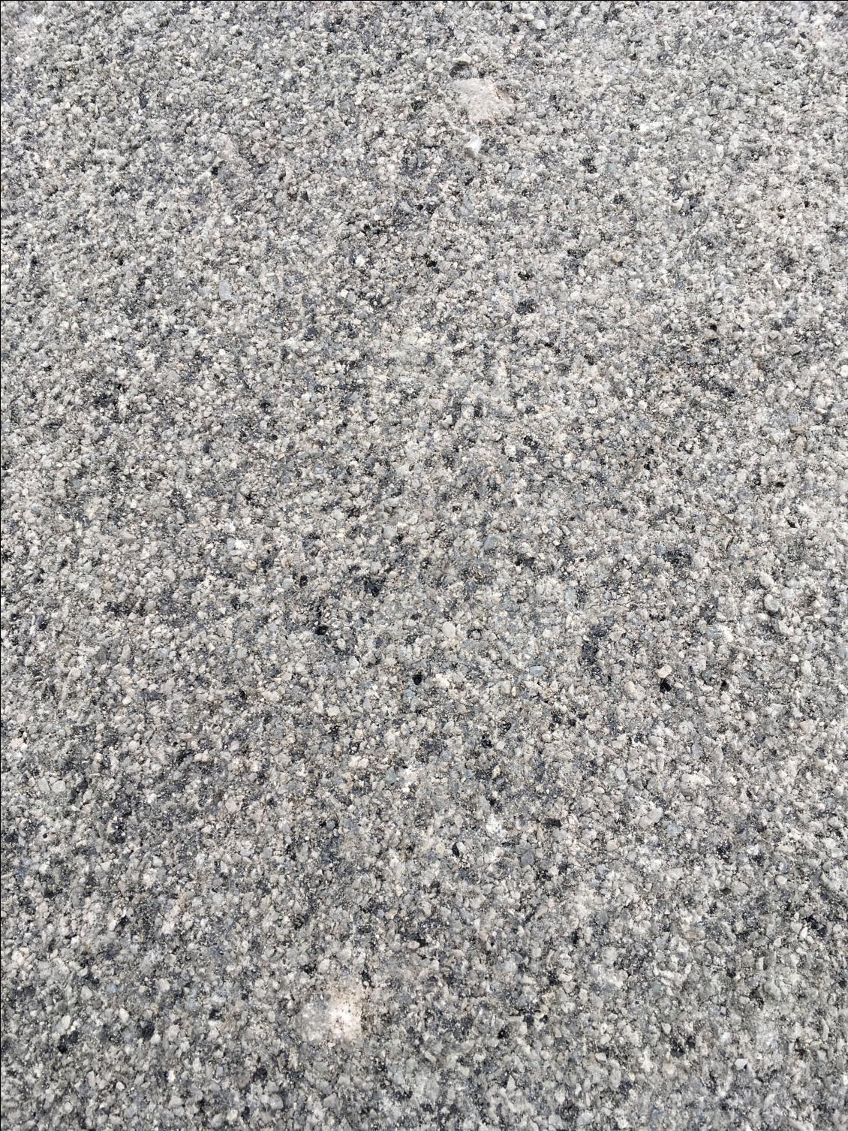
Larger stones in #11’s
Scrub Broom Removed
Salt & Pepper

Slide 4
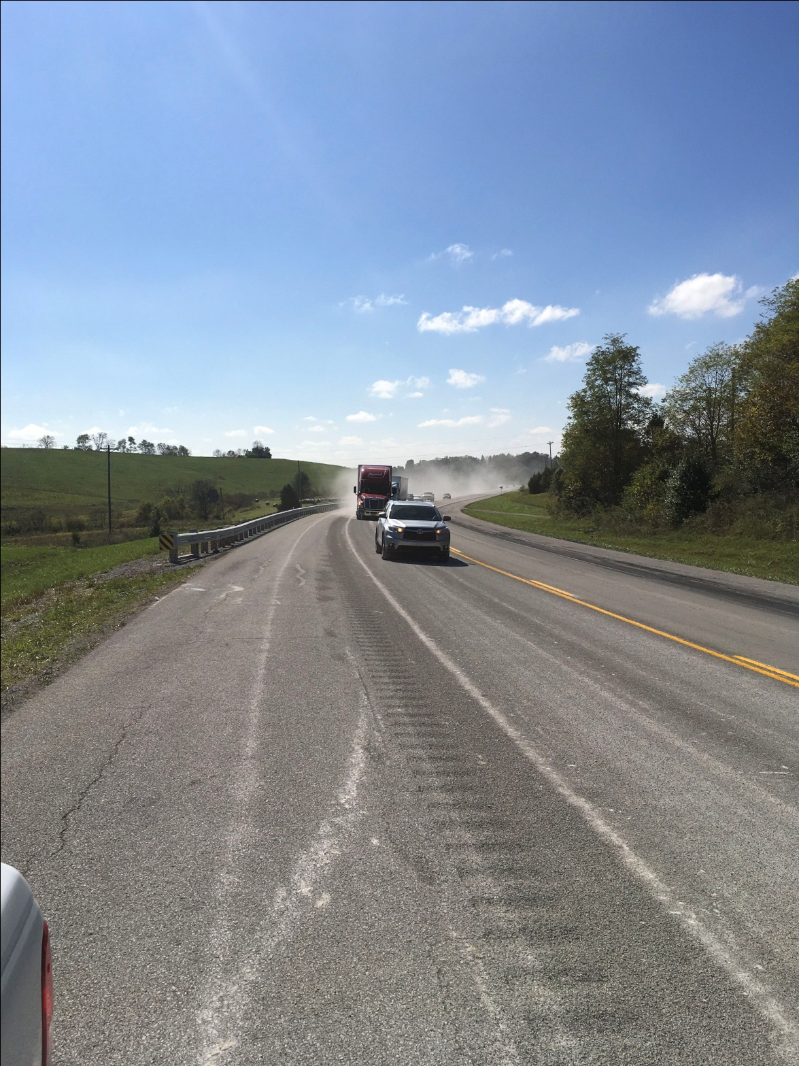
Some Dust – Not bad
Buildup of loose rock on centerline
Crushing rock on Edgeline or poor adhesion

Slide 5
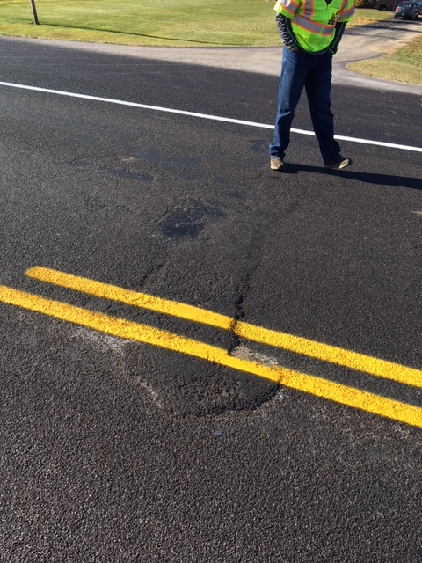
Areas where ended/ started new distributor of emulsion

Slide 6
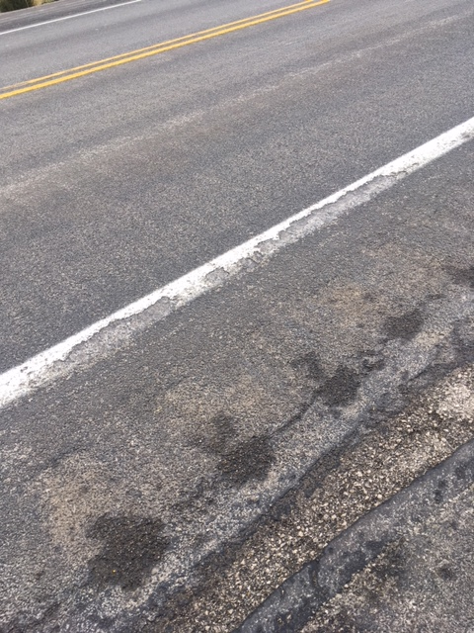
Edgeline pealed by snow plow
Crew said harder to remove snow/ice

Slide 7
NICHOLAS COUNTY US 68 PRESERVATION ECONOMICS
DOUBLE MICROSURFACE
TOTAL COST $388,600 ($4.32 / S.Y.)
1” ASPHALT OVERLAY IN 2010 - $500,000 ($5.52 /S.Y.)
COMPARATIVE SECTION -ADJACENT SECTION OF US68 RESURFACED IN 2009 AND RESURFACED AGAIN IN 2017 (8 YEAR LIFE)
TOTAL COST FOR 2 RESURFACING PROJECTS $99,713 /LN-MI
ASSUMING 16 YEARS OF LIFE = $6,230/LN-MI/YR
SUBJECT PM SECTION (DBL MICRO + SCRUB SEAL)= $49,700/LN-MI
ASSUMING 12 YEAR LIFE = $4,140/LN-MI/YR

